Slide 1
Zuul as a Load Balancer - A Quick Start

Slide 2
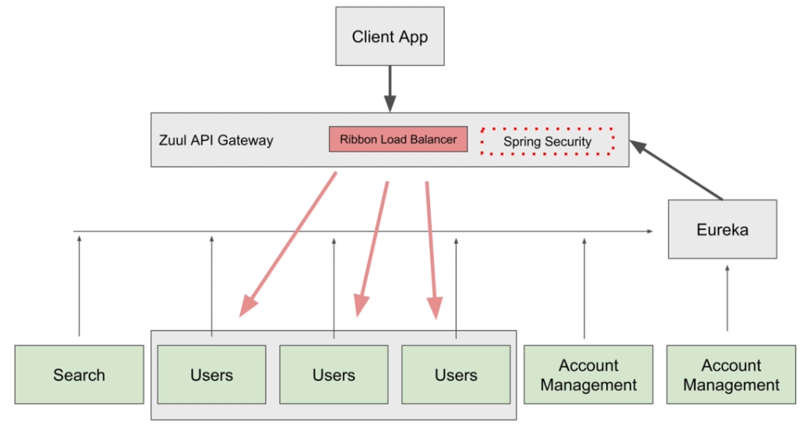

Slide 3
Starting Up More Microservices - starting more instances of ‘Users’ microservices

Slide 4
Trying How Load Balancer Works
// Access Microservices via API Gateway
//example: http://localhost:8011/users-ws/users/status/check

